Slide 1
Cervical Cancer Awareness: HPV 101
Presentation Created By : Sharon Bond PhD, CNM, FACNM, Medical University of South Carolina

Slide 2
Why is this Important?
Too many deaths from cervical cancer
12,000 new diagnoses every year
4200 women die yearly
Highest among women of color – screened, but less likely to follow-up an abnormal Pap
~ 100% preventable with vaccination, screening and early detection

Slide 3
Human Papillomavirus: HPV
Cervix cancer is caused by HPV
HPV common in men and women
HPV causes cervix, other genital and anal cancers in women
HPV causes penile, anal, some head/neck cancers in men
Sexual transmission: male-female, same sex; genital-genital; genital-mouth, anal-genital; microscopic breaks in skin
Vertical transmission-mother to fetus (rare)

Slide 4
Anyone Can Get HPV!
HPV is less likely to be cleared in women over 30.
Incidence of cervical rises in women 30 and older
Cervical cancer takes 10-20 years to develop. Women who are no longer sexually active should still have periodic Pap tests.

Slide 5
Where is the Cervix?

Slide 6
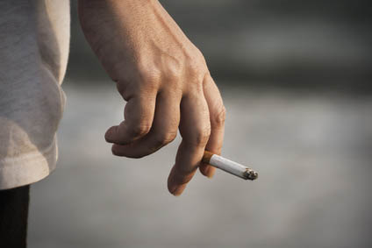
Risk factors for Cervical Cancer
Infection with HPV
Not getting regular Pap tests – begin testing at age 21
Illnesses that weaken your immune system (HIV)
Smoking
Diet
Multiple sexual partners throughout one’s lifetime
Chlamydia (STIs)
Poverty
Family history
DES

Slide 7
HPV Infection
CDC: 6 million new infections/year in US; 75% in young people 15-24
Most HPV goes away
Not all HPVs cause cancer
Most HPV causes no harm to most men and women
Some HPV infections linger and become cancer in men and women – we don’t know why

Slide 8
How Can People Check for HPV?
Women can be screened by a Pap test, HPV test, or pelvic exam (visual)
There are no FDA-approved ways to test men, diagnosis made by visual inspection

Slide 9
HPV-related Diseases
HPV infections cause external genital warts, abnormal Pap tests, vocal cord obstruction in young children and cancer in adults
Most get HPV when they start having sex but don’t know it!

Slide 10
Costs of HPV-related Diseases
HPV is expensive!
500,000 cases genital warts each year
Evaluating abnormal Pap tests, treating warts, office visits, cost billions of dollars
Psychological fear, shame and discomfort

Slide 11
Age Matters!!!

Slide 12
How to Prevent Cervical Cancer (Stop HPV Infection!)
Vaccination of girls and boys ages 11-12 (9-26)
Abstinence
Waiting until older to have sex
Condoms
Limit # of lifetime sex partners
Regular check-ups
Don’t smoke

Slide 13
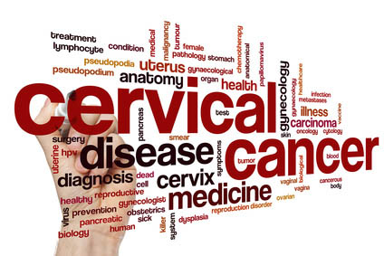
Time for Action!
Educate, educate! ACT!!
Knowledge is power – see the big picture
Health care providers
Churches, youth groups, parents/schools
Organizations: NCCC, Tamika’s Friends
Contact your legislators

Slide 14
Thank You!
References & Resources
http://www.cdc.gov/hpv/index.html
http://www.cervicalcancerfreecoalition.org/partners/partner-states/south-carolina-3/
http://www.nccc-online.org/index.php?option=com_content&view=article&id=122
http://tamikaandfriends.org/

